Slide 1


Full stack monitoring across application, infrastructure, and network with Azure Monitor
Paul Brennaman | Solution Architect
https://www.linkedin.com/in/paulbrennaman/
@brennaman3

Slide 2
Monitoring landscape – apps & infrastructure
Infrastructure
Apps
Network
</>

Slide 3
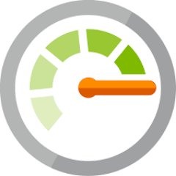
Azure Monitor
Full observability for your infrastructure, app and network
Metrics
Log
Common Store
Unified Monitoring
Data Driven Insights
Workflow Integrations
A common platform for all metrics, logs and other monitoring telemetry
Advanced diagnostics and analytics powered by machine learning capabilities
Rich ecosystem of popular DevOps, issue management, SIEM, and ITSM tools

Slide 4
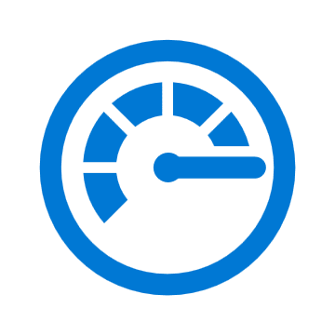

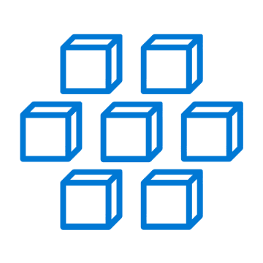
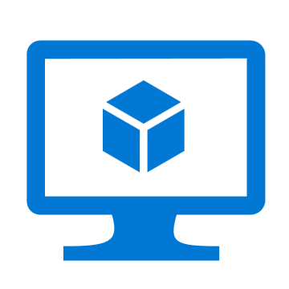
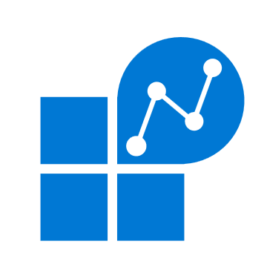
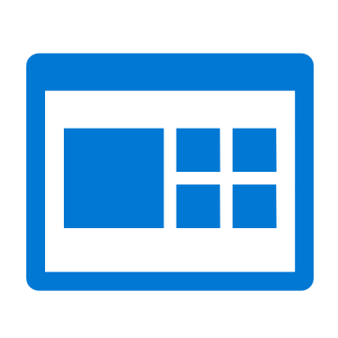

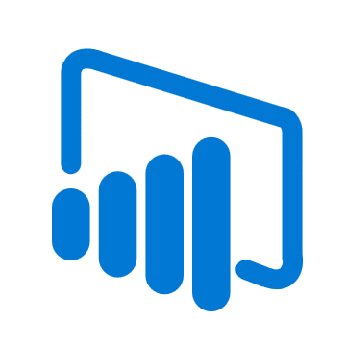

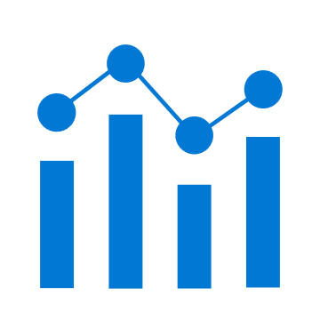
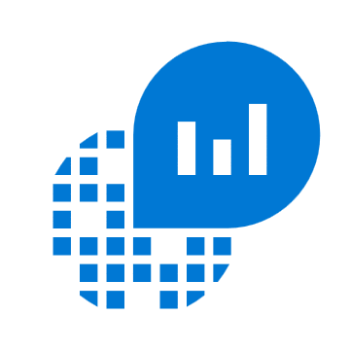


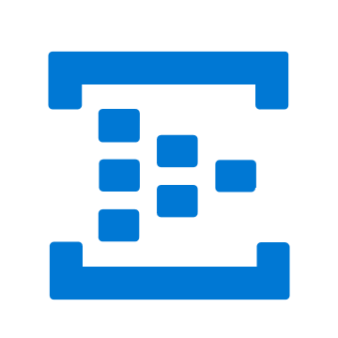
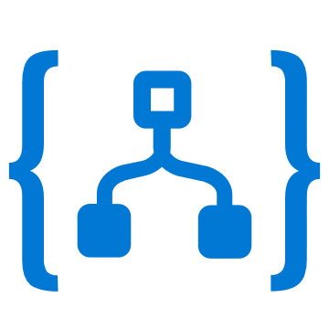
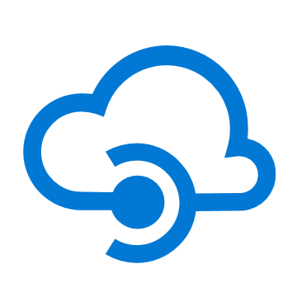
Azure Monitor
Insights
Application
Container
VM
Monitoring Solutions
Application
Operating System
Visualize
Metrics
Dashboards
Views
Power BI
Workbooks
Azure Resources
Azure Subscription
Analyze
Logs
Metrics Explorer
Log Analytics
Azure Tenant
Respond
Custom Sources
Alerts
Autoscale
Integrate
Event Hubs
Logic Apps
Ingest & Export APIs

Slide 5
Unified Monitoring

Slide 6
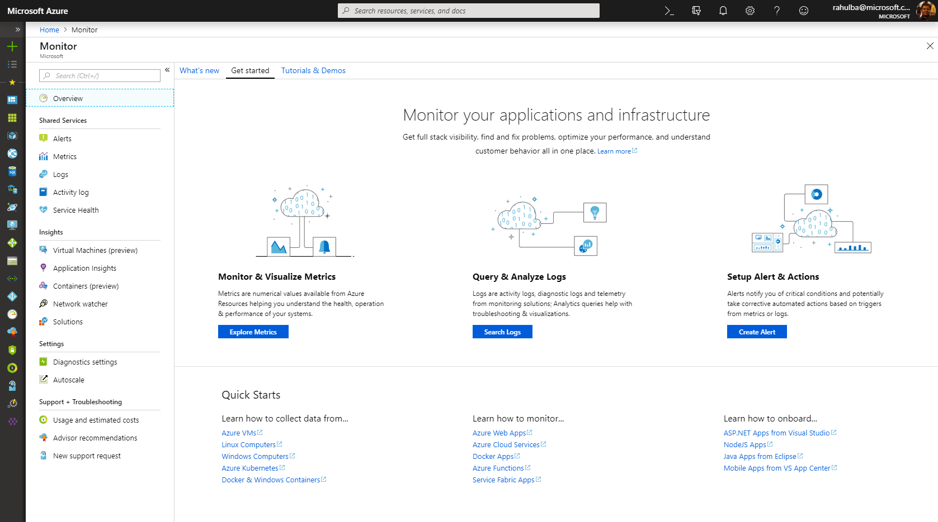
Unified Monitoring
One Metrics, One Logs, One Alerts across Azure/on-prem resources
Unified offering with App Insights & Log Analytics as integrated features
Integration into native Azure resource blades
Ability to send custom metrics & custom logs

Slide 7
Data Driven Insights

Slide 8
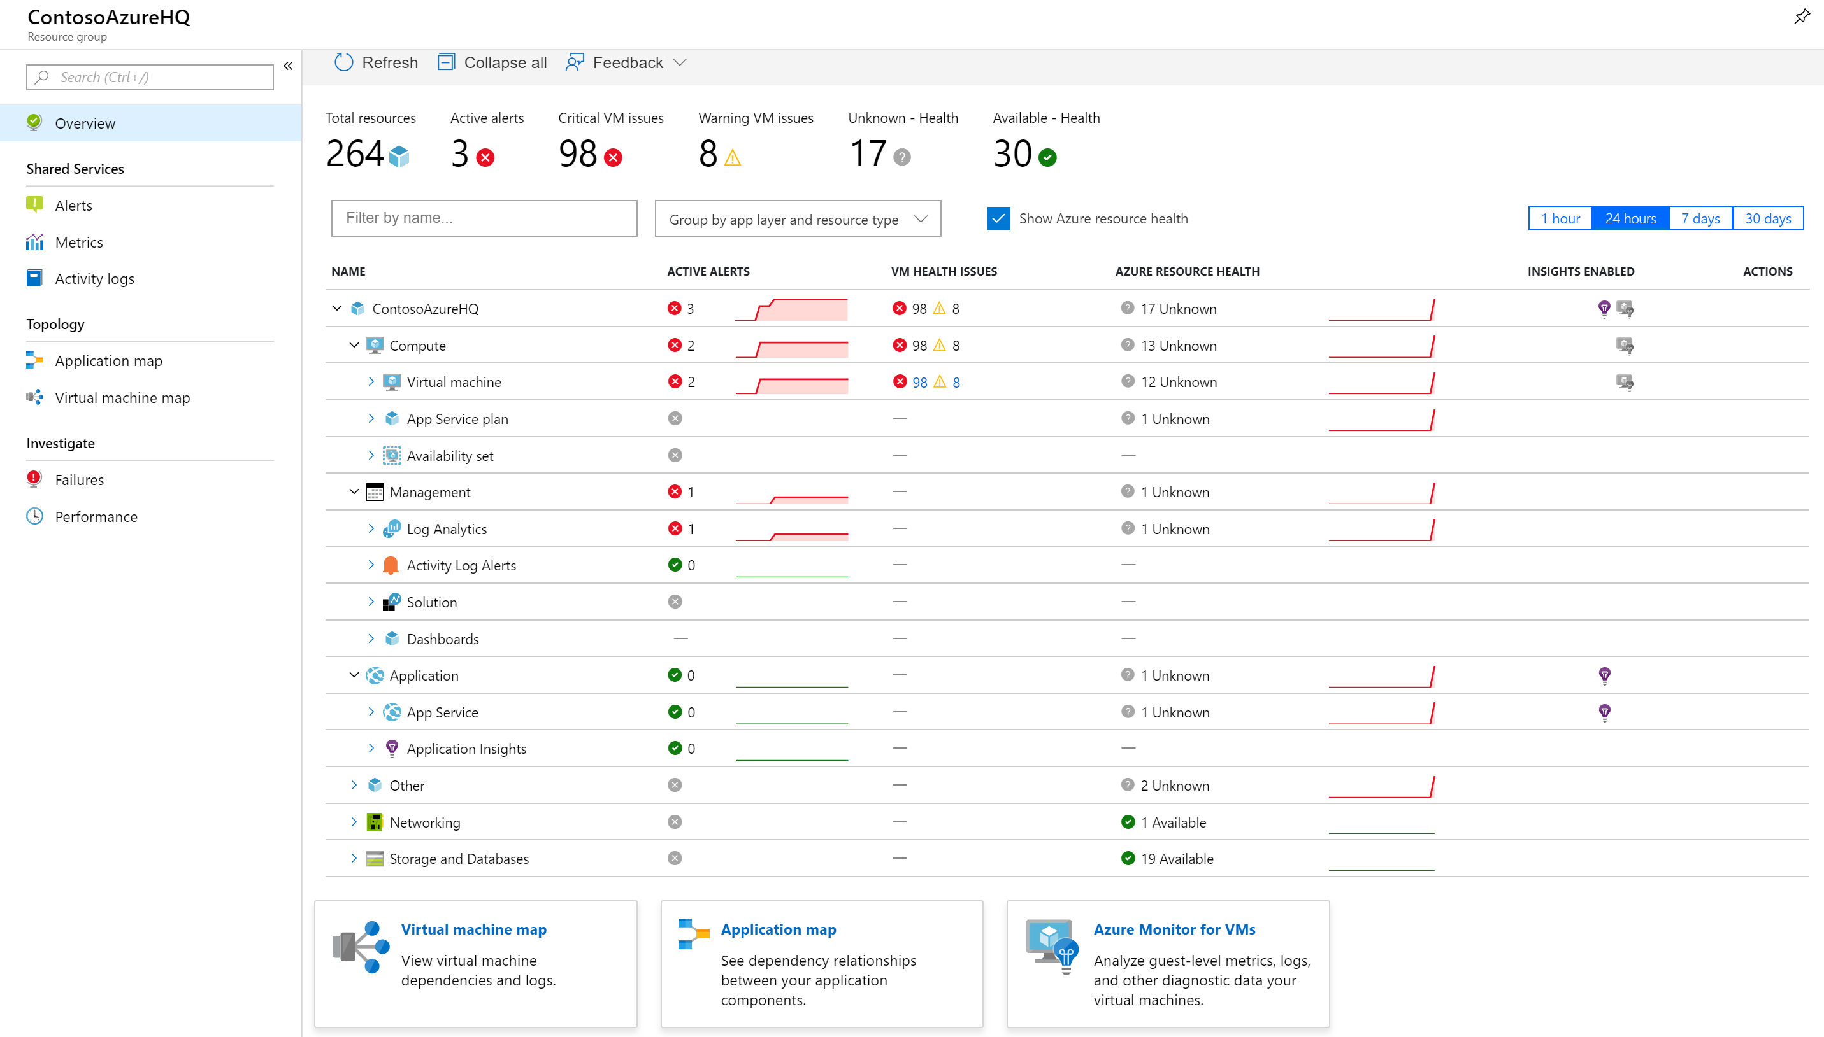
Full Stack Visibility in Resource Groups
Monitor health state of all resources
See alerts firing across app & infra
Jump to Application Map or VM Map
Drill down into failures or perf issues

Slide 9
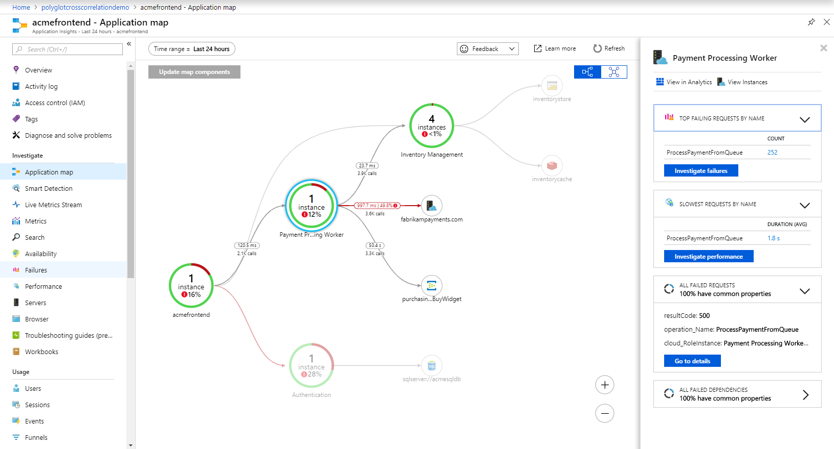
Diagnose E2E issues with Application Insights
Monitor apps in .NET, JS, Java, Node.js or any language with OSS SDKs
Visualize server/client connections & dependencies with App Map
Track E2E distributed transactions (including for Python & Go) NEW!
Drill down to code-level with Snapshot Debugging & Profiling
Understand end-user cohorts, behavior & engagement for planning

Slide 10
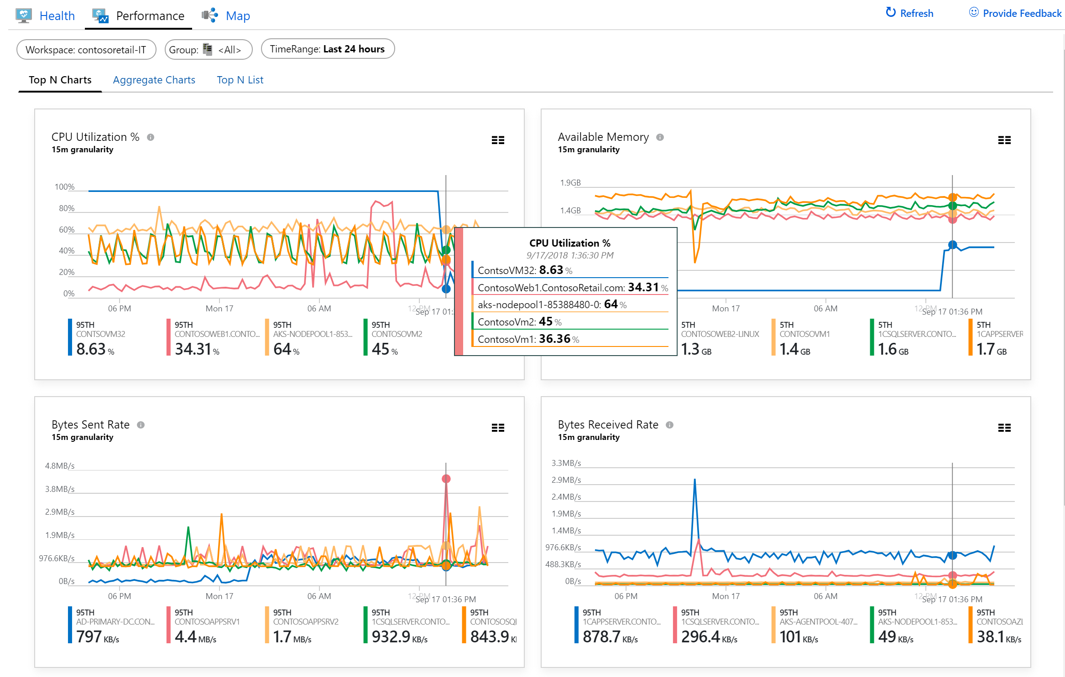
Rich Insights for Virtual Machines
Monitor single VMs or at scale
Identify & isolate host-level or guest-level health problems
Troubleshoot perf issues like CPU, memory, disk, and network
Visualize service dependencies & connection failures in Maps
Onboard at scale using PowerShell or Azure Policy

Slide 11
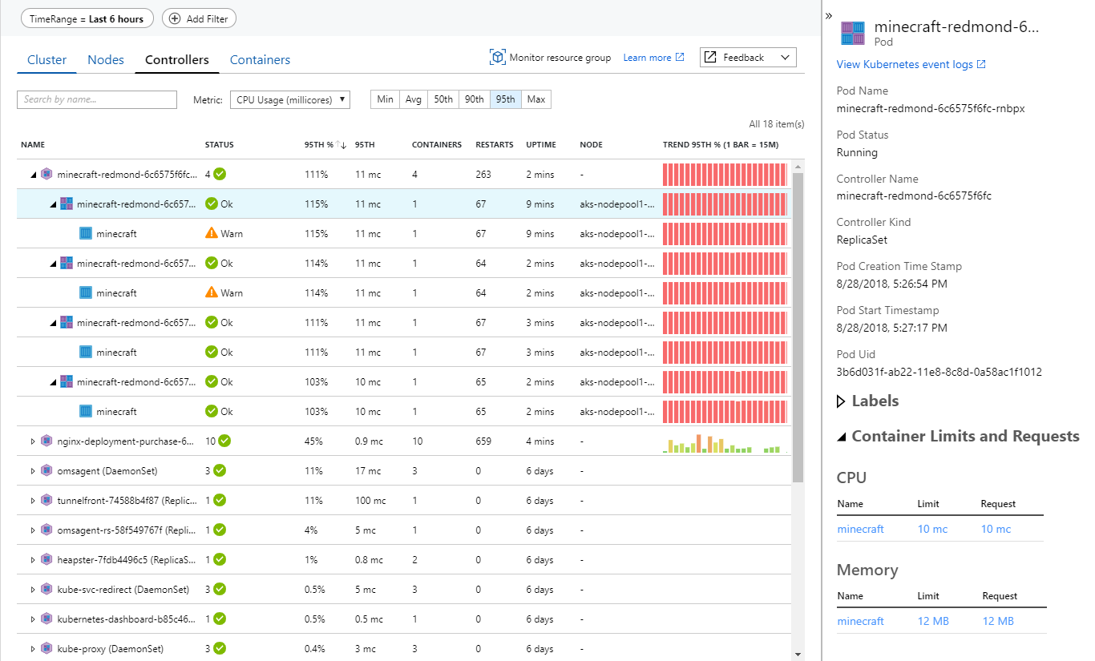
Drill down into AKS Containers
Monitor multi-cluster health & node/pod status NEW!
View overall perf across nodes, controllers and containers
Analyze Kubernetes event & container logs for troubleshooting
Understand cluster capacity needs under average or heaviest loads
Monitor containers on demand in AKS with virtual nodes NEW!

Slide 12

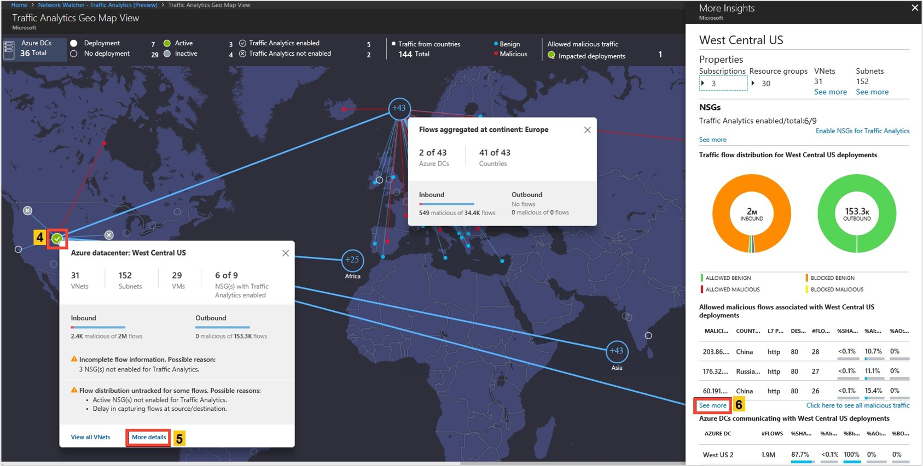
Monitor Network Health & Traffic
Secure and audit your network with Network Watcher Traffic Analytics
Discover and monitor ExpressRoute circuits, across subscriptions
Monitor ExpressRoute connectivity to virtual networks and O365
Monitor connectivity to LoB apps with Service Connectivity Monitor

Slide 13
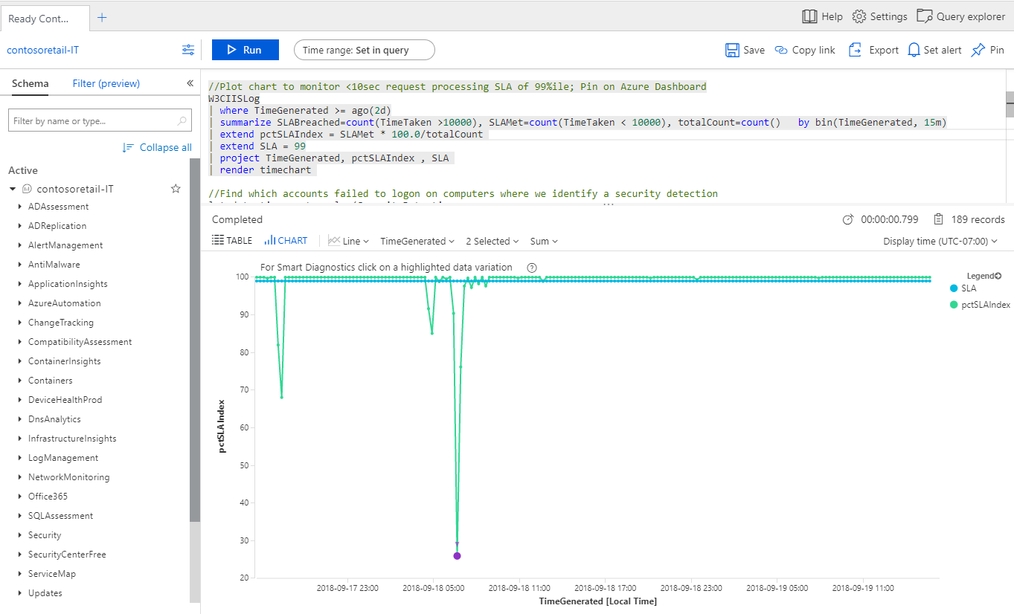
Advanced Queries with Log Analytics
Log Analytics advanced query experience now in Azure Portal
Central Analytics Platform across Monitoring, Management, Security
Run queries for investigations, statistics & root cause/trend analyses
Utilize ML algorithms for clustering and anomaly detection

Slide 14
Demo
Azure Monitor

Slide 15
Recap: What’s New
Unified Monitoring
Data Driven Insights
Scale &Security
One Metrics. One Logs. One Alerts.
Log Analytics query experience integrated into Azure Portal
Integration into native Azure resource blades
Configure Azure AD to send audit & sign-up logs to Azure Monitor
Ability to send Custom Metrics
Azure Monitor for resource groups
Azure Monitor for VMs (health, performance, and maps)
Multi-cluster health rollup view for AKS
Distributed Tracing for Python/Go in addition to .NET, Java & Node.js apps
Java Local Forwarder, Micrometer & Spring Boot support
Onboard VMs at scale via Azure Policy
Secured monitoring inside Virtual Networks
Store logs in firewall restricted secured storage accounts
Monitor ER and store NSG flow logs across subscriptions

Slide 16



Norwegian utility automates meter reading, improves customer service, and saves time and labor
As the power grid operator that serves 1.5 million Norwegians, Hafslund always looks for ways to optimize operations. For example, the company is replacing manual methods of reading customers’ electric meters with networked smart-metering. Hafslund chose Microsoft Azure as its cloud platform and Azure Kubernetes Service (AKS) to manage the company’s containerized software. Now, metering is faster and more accurate, billing is simpler, and collected data provides actionable insights into energy consumption patterns.
Microsoft Azure
Azure Kubernetes Service (AKS)
Azure Monitor for containers
Approx. 500 employees
Power and utilities
Norway

Slide 17
Workflow Integrations

Slide 18
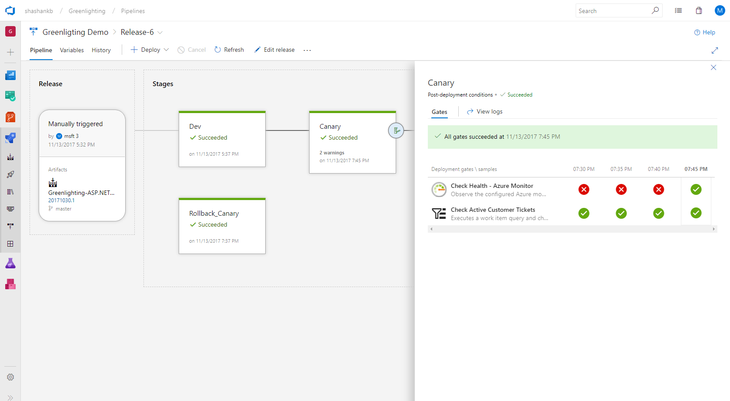
Continuous Monitoring for DevOps & IT Ops
Native IDE integrations in VS (.NET) and VS Code (Node.js)
Onboard with Azure Pipelines Release Management & DevOps Projects
Configure Pre- or Post-Deployment Quality Gates in Azure Pipelines
Run Load Test or Multi-Step Web Test for Synthetic Perf Monitoring
Work Item Management with Azure Boards for filing bugs and tracking
Alerts & Notifications with automated actions & ITSM integrations

Slide 19
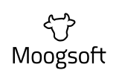
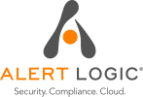






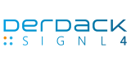

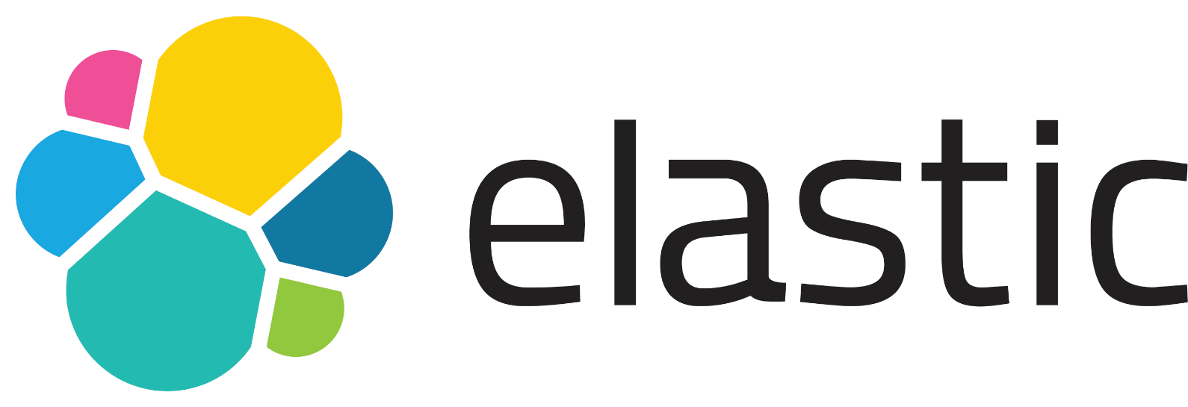





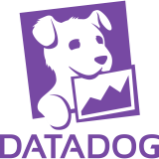

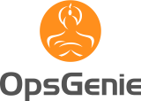
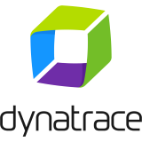
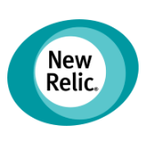
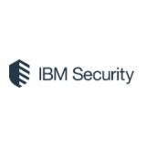
Integration with Monitoring & SIEM Tools
Azure Monitor is best for Azure, and provides both APM & SIEM capabilities
Open and extensible to continue using your favorite tools & solutions
Integrate your existing APM/Monitoring solutions with Azure Monitor
Route telemetry to your SIEM solutions for analytics & security management

Slide 20
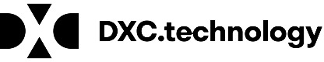



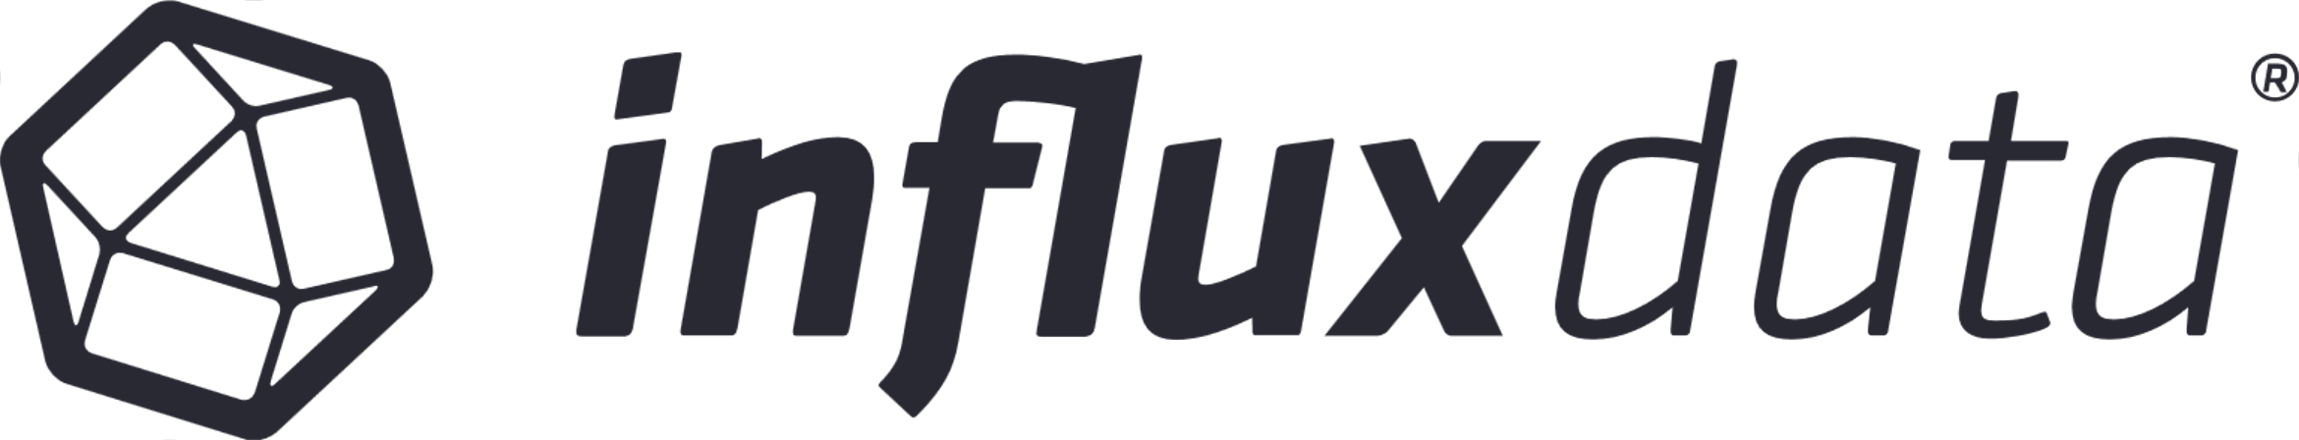
Partner Solutions for Apps & Workloads
ISVs / MSPs / SIs are extending and building solutions on top of Azure Monitor for specific scenarios & workloads
Some solutions help monitor diverse technologies deployed on Azure
Apache, Citrix NetScaler, F5 SLB, SAP Hana, Oracle, etc.
Others use their proprietary technologies to provide deeper scenario specific insights or diagnostics workflows

Slide 21
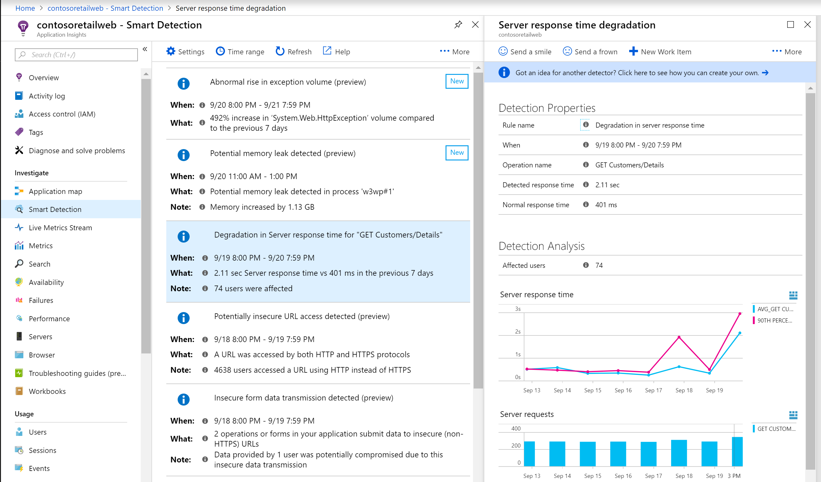
Azure Monitor & AIOps
Proprietary AI based Smart Detection for discovering anomalies
Smart Alert Management with Dynamic Thresholds for automatic baselining
Partnering with NMLStream to integrate additional ML capabilities for more powerful AIOps
Working with ML community internal/external to bring deeper intelligence for DevOps/SRE teams

Slide 22
Roadmap
Rich insights for Azure Storage, SQL & Service Fabric Mesh
RBAC per data type in Log Analytics
Support for containers on demand for AKS with virtual nodes
Support live logs for containers and Kubernetes events
Smart detections and alerts with Dynamic Thresholds
Expanded Azure support and interoperability for Distributed Tracing
Exception tracking and custom metrics for Python and Go apps
Auto enablement of app monitoring for App Services / Windows VMs (with WAD)
Expanded region availability across public & sovereign clouds
Latency improvements for Alerts, Logs & Metrics

Slide 23
Resources & related sessions
Azure Monitor Documentation – https://aka.ms/MonitoringDocs
Resources, Tutorials & What’s New – https://aka.ms/AzMonOverview
Query Language Course on Pluralsight – https://aka.ms/KQLPluralsight

